Slide 1
Week 5 Update
12 February 2021
SR

Slide 2
Agenda
Recap
Updates
Constant cadence
Muscles added
Next 3 weeks plan
Priority action items
SR

Slide 3
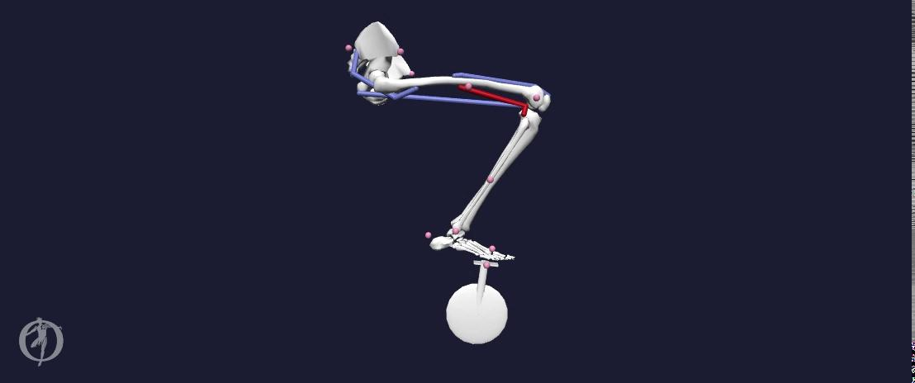
Recap
Success! (8e trial)
SR

Slide 4
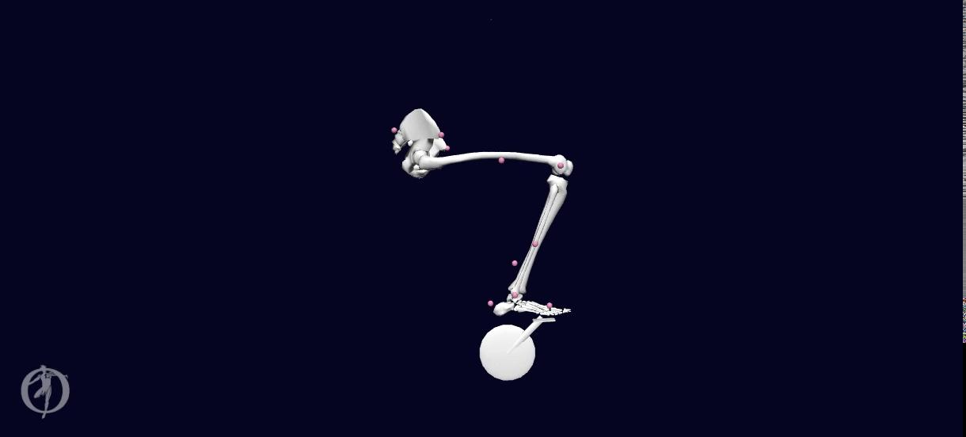
Updates: Constant Cadence
Using bare bones model
DG
Notes:
Carmichael said we should just do with all muscles since we can drive cadence at constant speed

Slide 5

Updates: Muscles Added
More Success!
Gastrocnemius added
Gastrocnemius & Tibialis Anterior added
CC

Slide 6
Plan: Next 3 Weeks
Parameterizing Model Features
1. Dynamics Solver
2. Imposed Cadence
Saddle Position
External Forces
Muscles
OpenSim Model
DG/SR

Slide 7
Plan: Next 3 Weeks
OpenSim Model
Body Kinematics
Muscle States
Metabolics
Compare Result Quantities
DG/SR

Slide 8
Priority Items & Questions
Add Muscles: Gastrocnemius, tibialis anterior
Soleus and more TBD
Add Ankle Angle DOF
Saddle position automation tool
Pedal forces (GRF)
Analyze using constraints
Manually parameterize using dynamics
Get results with varying position & RPM
2-leg model
In parallel/1 person spin off
Drag force consideration
Hand-calculations
Overall direction of project?
CEC
Notes:
2 leg model - if it makes sense to have 1 person to work in //
This seems to be a future area of research for Specialized, even if it is unsuccessful, document challenges
Why do people get out of the saddle?
More important than having every muscle super accurate on one side but not having overarching dynamics correct
Drag force consideration -- completely out of scope
Clarification of what optimization means
Muscles added -- makes more sense to get on a call with guys who run retul fit
Does it make sense to group muscles?
Justin yield entirely to us
Matching markers?
Rigid body movement/ motion tracking

Slide 9
Clarifications needed?
Efficiency definition
Definition of successful trial
Documentation of changes in CMC tool files
Background information/ related works
Complexity for additions to model
CEC
Notes:
Efficiency - what is being exactly quantified?
Energy
Force-l, Force-vel
Resistance torque?
Pair torque w force/angle
Justin to send ballpark values
Justin: doesnt need to be really complex, just try to match even stationary bike/ergometer data
Compare muscle activation to lit review
Might be useful to show comparison between traditional biomech research methods vs how that translates to opensim (forward dynamics, CMC) tools
Intermediate values of CMC output would be useful for Justin to determine the most efficient optimization
Change initial crank angle to 45 degrees
Give starting velocity
Read me for google drive (dont have to repeat documentation, just where info is)

Slide 10
Timeline
Week 2 | Week 3 | Week 4 | Week 5 | Week 6 | Week 7 | Week 8 | Week 9 | Week 10
1/22 | 1/29 | 2/5 | 2/12 | 2/19 | 2/26 | 3/5 | 3/12 | 3/19
OpenSim learning |  |  | Define workflow | Parameterize saddle height
Literature research |  |  |  | Parameterize muscles
Workflow development |  |  | Create tool for force parameterization |  |  | Collect data on parameterizations
Meet with OpenSim experts & document research and process thoroughly
 | Compute muscle forces & metabolic output through CMC
→ Currently in progress
CEC
Notes:
[cc] This timeline has a visual representation of our work for the next several weeks. The blocks in green are currently being worked on and we have a couple weeks at the end for buffer and final wrap up activities.

Slide 11
Questions/Asks
Drag
Additional Leg
Priority of all tasks
all
Notes:
Spring gauge on a crank - power crank
Professional versions output 200Hz
Literature is probably a better source than Specialized

Slide 12
Parameterization
Cadence C1
0 added muscles M0
Theta T1
Cadence C2
Radius R1
1 added muscles M1
Theta T2
Cadence C3
Radius R2
2 added muscles M2
Theta T3
...
Radius R3
...
CMC trials
...
...
Cadence Cn
N added muscles Mn
Theta Tn
Radius Rn
Saddle Position
Muscles
Cadence
all

